Slide 1
MATHEMATICS FOR COMPUTING
WEEK 2 - LECTURE
FUNCTIONS, MODULE ARITHMETIC AND SURDS

Slide 2
Learning Outcomes
By the end of the lecture the successful student will be able to:
Basic concepts of function
Working with modular arithmetic - addition and multiplication
Understanding surds

Slide 3
Function
A technical definition of a function is: a relation from a set of inputs to a set of possible outputs where each input is related to exactly one output.
f ( X )
f ( X ) = … is the classic way of writing a function. And there are other ways, as you will see!

Slide 4
Describing Function
It is customary to give functions names, like f, g, or h, and if we call this function f, we generally use the following notation to describe it:
The standard terminology for describing this function f is:
The value of f at argument 1 is 1, its value at argument 2 is 1, and its value at argument 3 is 2, which we write as
f(1)=1,f(2)=1,f(3)=2.

Slide 5
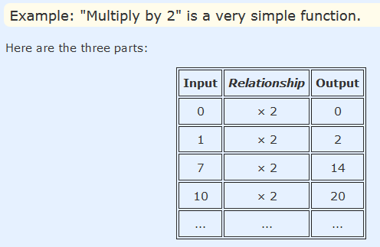
Three Main Parts
The input
The relationship
The output

Slide 6
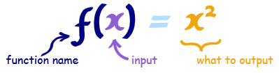
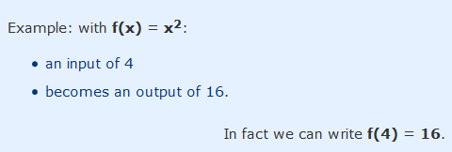
Structure of Function
Let's use "f":
We say "f of x equals x squared“
What goes into the function is put inside parentheses () after the name of the function:
So f (x) shows us the function is called "f", and "x" goes in
And we usually see what a function does with the input:
f (x) = x² shows us that function "f" takes "x" and squares it.

Slide 7
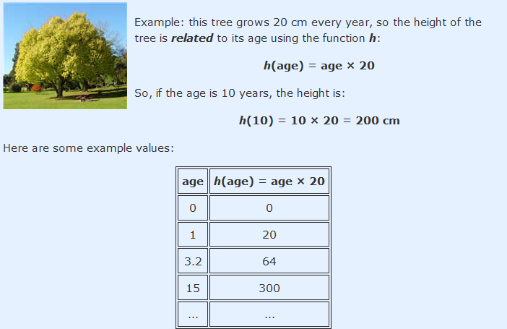
Function Relationship
A function relates an input to an output.
Saying "f (4) = 16" is like saying 4 is somehow related to 16. Or 4 → 16.

Slide 8
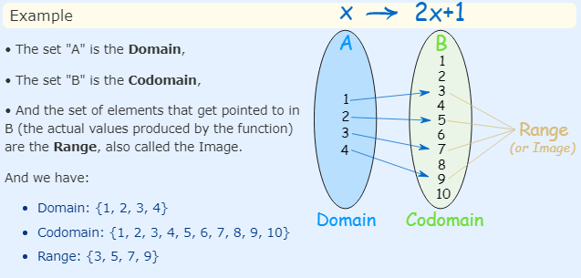
Domain, Codomain and Range
There are special names for what can go into, and what can come out of a function:
What can go into a function is called the Domain
What actually comes out of a function is called the Range

Slide 9
What Types of Things Do Functions Process?
For example, the tree-height function h(age) = age×20 makes no sense for an age less than zero.
So we need something more powerful, and that is where sets come in:
A set is a collection of things.
Here are some examples:
Set of even numbers: {..., -4, -2, 0, 2, 4, ...}
Set of clothes: {"hat","shirt",...}
Set of prime numbers: {2, 3, 5, 7, 11, 13, 17,..}
Positive multiples of 3 that are less than 10: {3, 6, 9}
Each individual thing in the set (such as "4" or "hat") is called a member, or element.

Slide 10
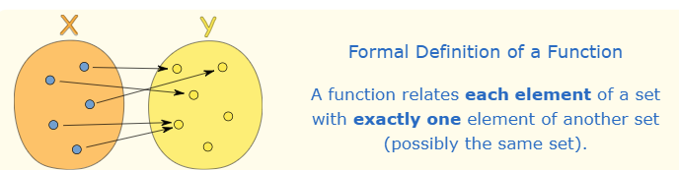
A Function is Special
This can be said in one definition:

Slide 11
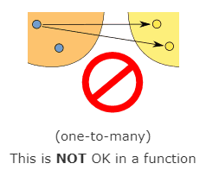
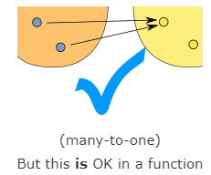
The Two Important Things!
"...each element..." means that every element in X is related to some element in Y. We say that the function covers X (relates every element of it). (But some elements of Y might not be related to at all, which is fine.).
"...exactly one..." means that a function is single valued. It will not give back 2 or more results for the same input.
So "f(2) = 7 or 9" is not right!

Slide 12
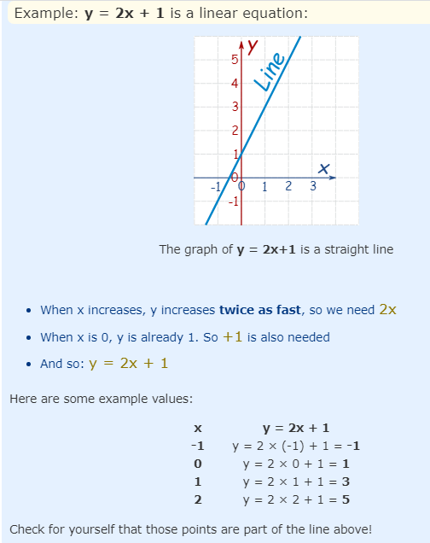
Linear Functions
A linear function is an equation that describes a straight line on a graph. You can remember this by the "line" part of the name linear equation.

Slide 13
Linear Equations - Standard Form
Linear equations have a standard form that looks like this: Ax + By = C
Where A, B, and C are coefficients (numbers) while x and y are variables. You can think of the x and y variables as points on a graph.
Example linear equations: You can plug numbers into A, B, and C of the above standard form to make linear equations:
2x + 3y = 7
x + 7y = 12
3x - y = 1

Slide 14
Graphing Linear Equation
In order to graph a linear equation you can put in numbers for x and y into the equation and plot the points on a graph. One way to do this is to use the "intercept" points. The intercept points are when x = 0 or y = 0. Here are some steps to follow:
Plug x = 0 into the equation and solve for y
Plot the point (0,y) on the y-axis
Plug y = 0 into the equation and solve for x
Plot the point (x,0) on the x-axis
Draw a straight line between the two points.

Slide 15
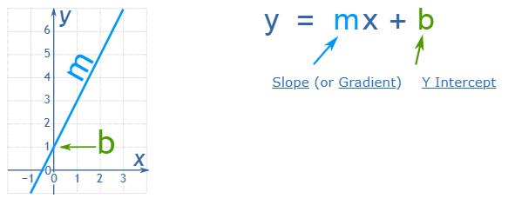
Linear Equations – Slope Form
The most common form is the slope-intercept equation of a straight line.
Example: y = 2x + 1
Slope: m = 2
Intercept: b = 1
slope = (change in y) divided by the (change in x) = (y2 - y1)/(x2 - x1) intercept = the point where the line crosses (or intercepts) the y-axis

Slide 16
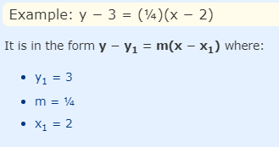
Linear Equations – Point Slope Form
The point-slope form of linear equation is used when you know the coordinates of one point on the line and the slope. The equation looks like this:
y - y1 = m(x - x1)
y1, x1 = the coordinates of the point you know
m = the slope, which you know
x, y = variables

Slide 17
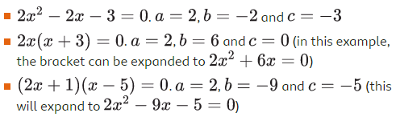
Quadratic Equations
A quadratic equation contains terms up to x². There are many ways to solve quadratics. All quadratic equations can be written in the form ax²+bx+c=0 where a, b and c are numbers (a cannot be equal to 0, but b and c can be).
Here are some examples of quadratic equations in this form.

Slide 18
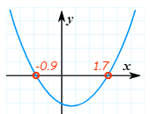

How To Solve Them?
The "solutions" to the Quadratic Equation are where it is equal to zero. They are also called "roots", or sometimes "zeros“.
There are usually 2 solutions (as shown in this graph).
We can use the special Quadratic Formula:

Slide 19
Modular Arithmetic
Modular arithmetic is a system of arithmetic for integers, which considers the remainders. In modular arithmetic, numbers "wrap around" upon reaching a given fixed quantity (this given quantity is known as the modulus) to leave a remainder.
An intuitive usage of modular arithmetic is with a 12-hour clock. If it is 10:00 now, then in 5 hours the clock will show 3:00 instead of 15:00. 3 is the remainder of 15 with a modulus of 12.

Slide 20
Example
First perform the usual arithmetic, and then find the remainder. For example, to find 123+321 (mod 11) 123 + 321, we can take
123+321=444
And divide it by 11, which give us
123 + 321 ≡ 4 (mod 11).

Slide 21
Example
Another approach that we could take is to first finding the remainders of 123 and 321 when divided by 11.
In this example, since 123≡2 (mod 11) and 321≡2 (mod 11), we can conclude that,
123 + 321​ ≡ 2 + 2 (mod 11).​
≡ 4 ​(mod 11)

Slide 22

Modular Addition
Below are some interesting properties of Modular Addition:
Example: Find the remainder of 22 + 26 + 29 when divided by 5.
Solution: On dividing 22 by 5 we get 2 as remainder. On dividing 26 by 5 we get 1 as remainder. On dividing 29 by 5 we get 4 as remainder. Remainder of the expression (22 + 26 + 29)/5 will be equal to (2 + 1 + 4)/5. Combined remainder will be equal to remainder of 7/5 i.e. 2.

Slide 23
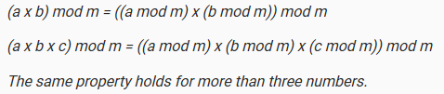
Modular Multiplication
Below are some interesting properties of Modular Multiplication.
Example: Find the remainder of 15 x 17 x 19 when divided by 7.
Solution: On dividing 15 by 7 we get 1 as remainder. On dividing 17 by 7 we get 3 as remainder. On dividing 19 by 7 we get 5 as remainder. Remainder of the expression (15 x 17 x 19)/7 will be equal to (1 x 3 x 5)/7. Combined remainder will be equal to remainder of 15/7 i.e. 1.

Slide 24
Surds
Surds are numbers left in 'square root form' (or 'cube root form' etc). They are therefore irrational numbers. The reason we leave them as surds is because in decimal form they would go on forever and so this is a very clumsy way of writing them.
Example 1: √2 (square root of 2) can't be simplified further so it is a surd
Example 2: √4 (square root of 4) can be simplified (to 2), so it is not a surd!

Slide 25
References
https://en.wikipedia.org/wiki/Function_(mathematics)
https://www.khanacademy.org/math/algebra/x2f8bb11595b61c86:functions
https://nrich.maths.org/4350
https://mathworld.wolfram.com/ModularArithmetic.html
https://artofproblemsolving.com/wiki/index.php/Modular_arithmetic/Introduction
https://www.youtube.com/watch?v=d-n92Ml1iu0
https://www.youtube.com/watch?v=568dGLFTom8

Slide 26
Done for Today
Thank You

